Slide 1
Fundamental Concepts
What Is a Graph?
Vertex, Edge, Loop, Isolated Vertex, Parallel Edges.
Simple Graph, Directed Graph and its edges, Adjacent and neighbors Vertices, Finite Graph, Null Graph, Complement of a graph.
Bipartite Graphs, Paths and Cycles.
Subgraphs, Connected and Disconnected Graphs.
Degree of a vertex, In-degree and Out-degree of a Vertex.

Slide 2
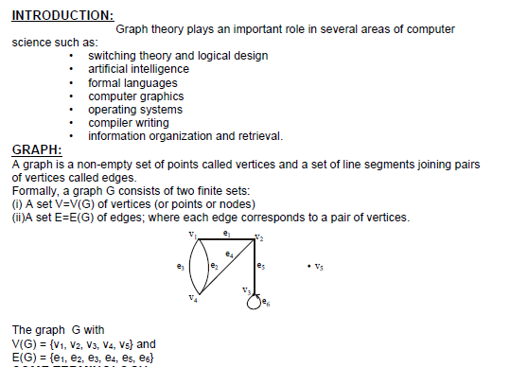
Introduction To Graph Theory

Slide 3
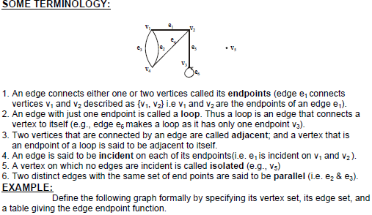
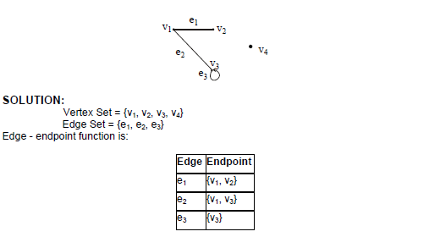
Terminology

Slide 4
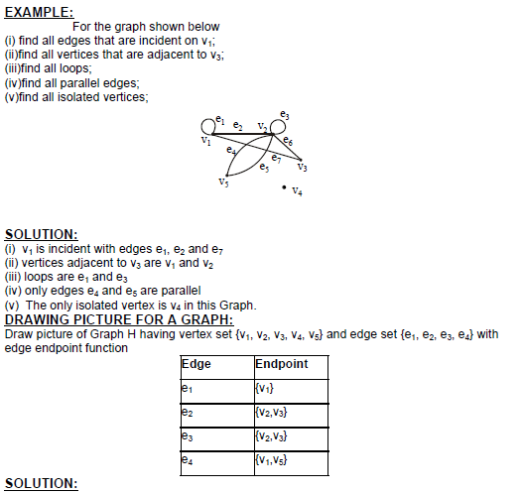
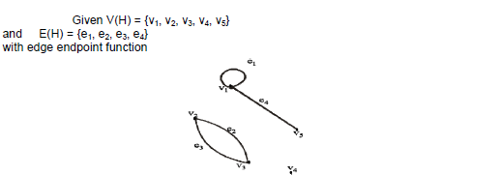

Slide 5
Simple Graph
Simple graph : A graph has no loops or multiple edges
Multiple
edges
loop
It is not simple.
It is a simple graph.

Slide 6
Directed Graph and its edges
When a digraph models a relation, each ordered pair is the (head, tail) pair for at most one edge.
In this setting as with simple graphs, we ignore the technicality of a function assigning endpoints to edges and simply treat an edge as an ordered pair of vertices.
Graph Theory
Ch. 1. Fundamental Concept

Slide 7
Adjacent, Neighbors
Two vertices are adjacent and are neighbors if they are the endpoints of an edge
Example:
  A and B are adjacent
  A and D are not adjacent
A
B
C
D

Slide 8
Finite Graph, Null Graph
Finite graph : Graph whose vertex set and edge set are finite.
Null graph : The graph whose vertex set and edges are empty.

Slide 9
Complement
Complement of G: The complement G’ of a simple graph G :
  A simple graph
  V(G’) = V(G)
  E(G’) = { uv | uv ∉E(G) }
u
u
v
y
v
G
y
G’
w
x
w
x

Slide 10
Bipartite Graphs
A graph G is bipartite if V(G) is the union of two disjoint independent sets called partite sets of G
Also: The vertices can be partitioned into two sets such that each set is independent
Job Assignment Problem
Workers
Jobs

Slide 11
Path and Cycle
Path : a sequence of distinct vertices such that two consecutive vertices are adjacent
  Example: (a, d, c, b, e) is a path
  (a, b, e, d, c, b, e, d) is not a path; it is a walk
Cycle :A cycle is a closed walk in which all the edges are different.
  Example: (a, d, c, b, e, a) is a cycle
a
b
c
e
d

Slide 12
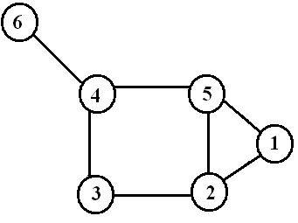
1,2,5,1 2,3,4,5,2
3-cycle 4-cycle

Slide 13
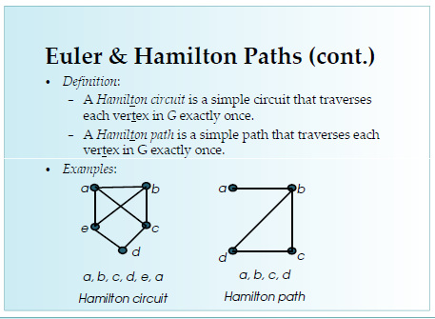

Slide 14
Subgraphs
A subgraph of a graph G is a graph H such that:
  V(H) ⊆ V(G) and E(H) ⊆ E(G) and
  The assignment of endpoints to edges in H is the same as in G.

Slide 15
Subgraphs
Example: H₁, H₂, and H₃ are subgraphs of G
a
b
G
c
e
d
a
b
a
b
c
H₃
c
H₁
H₂
d
e
d
e
d

Slide 16
Connected and Disconnected
Connected : There exists at least one path between two vertices
Disconnected : Otherwise
Example:
  H₁ and H₂ are connected
  H₃ is disconnected
a
b
a
b
H₁
c
H₂
H₃
c
d
e
d
d
e

Slide 17
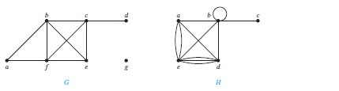
Degree of a vertex
The degree of a vertex in an undirected graph is the number of edges incident with it, except that a loop at a vertex contributes twice to the degree of that vertex. The degree of the vertex v is denoted by deg(v).
What are the degrees and what are the neighborhoods of the vertices in the graphs G and H displayed in Figure?

Slide 18
In G, deg(a) = 2, deg(b) = deg(c) = deg(f ) = 4, deg(d ) = 1, deg(e) = 3, and deg(g) = 0.
The neighborhoods of these vertices are N(a) = {b, f }, N(b) = {a, c, e, f }, N(c) = {b, d, e, f }, N(d) = {c}, N(e) = {b, c, f }, N(f ) = {a, b, c, e}, and N(g) = ∅.
In H, deg(a) = 4, deg(b) = deg(e) = 6, deg(c)= 1, and deg(d ) = 5. The neighborhoods of these vertices are N(a) = {b, d, e}, N(b) = {a, b, c, d, e}, N(c) = {b}, N(d) = {a, b, e}, and N(e) = {a, b, d}.

Slide 19
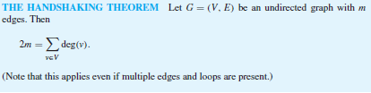


Slide 20

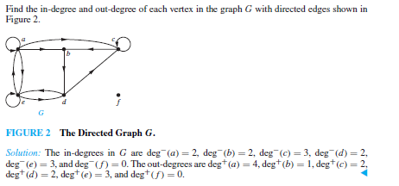

In-degree and Out-degree of a Vertex

Slide 21
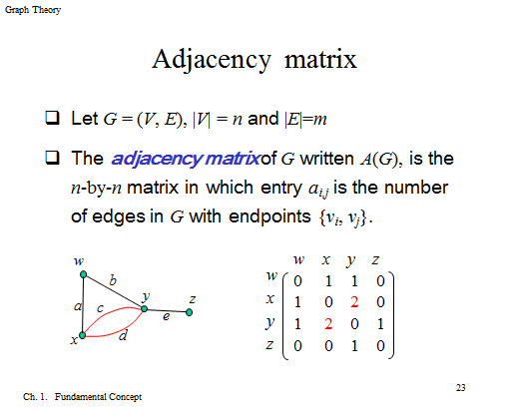

Slide 22
Adjacency Matrix
-Directed Multigraphs
A=
2
1
4
3

Slide 23
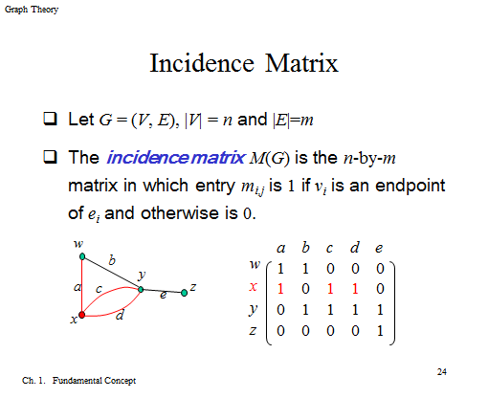

Slide 24
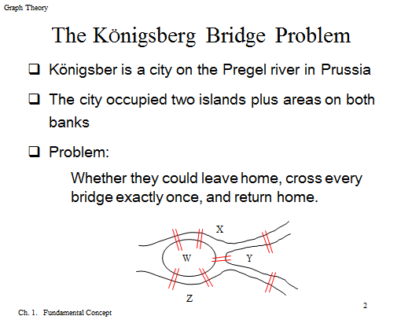

Slide 25
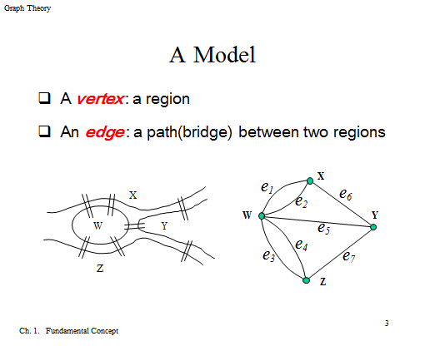

Slide 26
The
End

Slide 27
Tree In Graph Theory
A connected graph that contains no simple circuits is called a tree. Trees were used as long ago as 1857, when the English mathematician Arthur Cayley used them to count certain types of chemical compounds. Since that time, trees have been employed to solve problems in a wide variety of disciplines, as the examples in this chapter will show.
Trees are particularly useful in computer science, where they are employed in a wide range of algorithms. For instance, trees are used to construct efficient algorithms for locating items in a list. They can be used in algorithms, such as Huffman coding, that construct efficient codes saving costs in data transmission and storage.
Trees can be used to study games such as checkers and chess and can help determine winning strategies for playing these games. Trees can be used to model procedures carried out using a sequence of decisions. Constructing these models can help determine the computational complexity of algorithms based on a sequence of decisions, such as sorting algorithms.

Slide 28
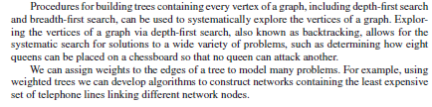

Slide 29
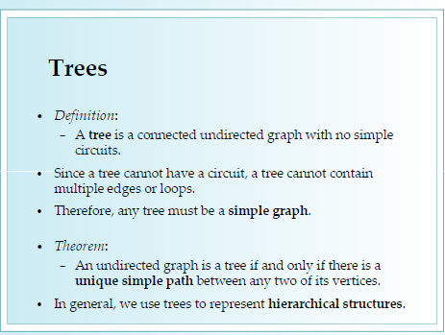

Slide 30
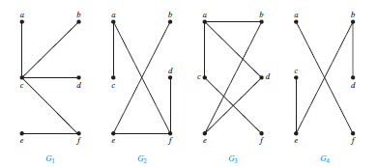


Slide 31
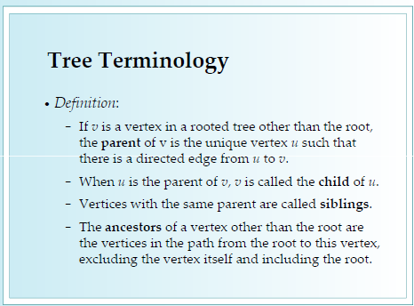

Slide 32
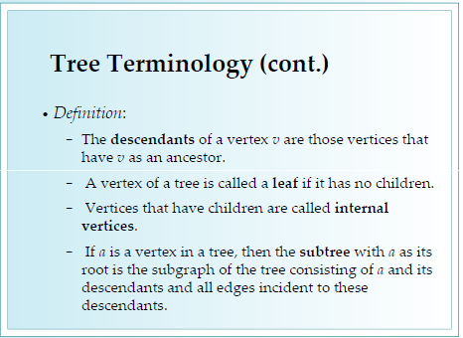

Slide 33


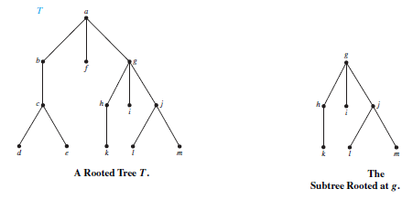

Slide 34
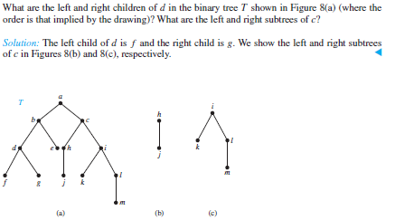

Slide 35
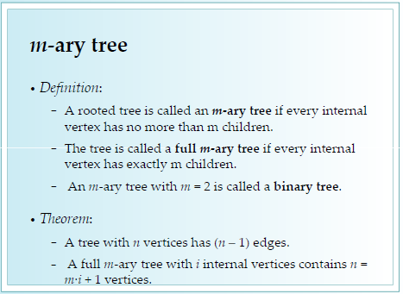

Slide 36
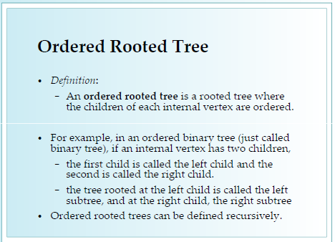

Slide 37
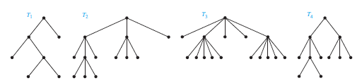


Slide 38
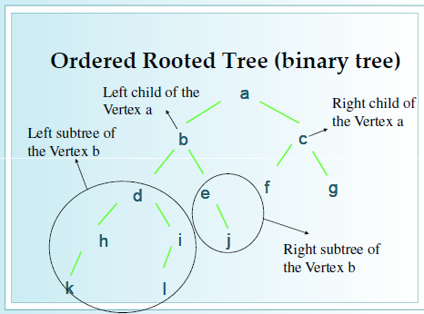

Slide 39
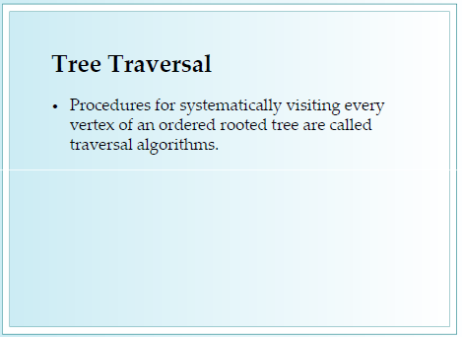

Slide 40
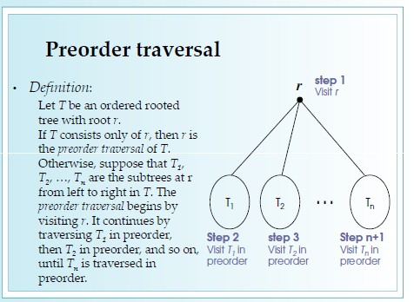

Slide 41
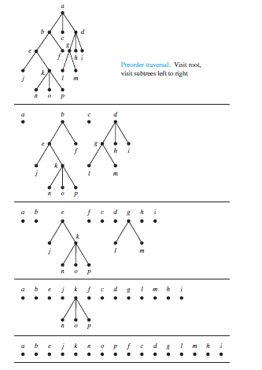

Slide 42
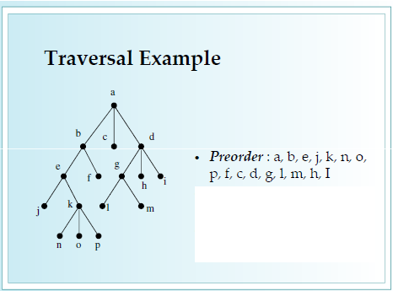

Slide 43
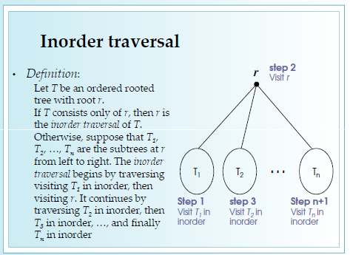

Slide 44
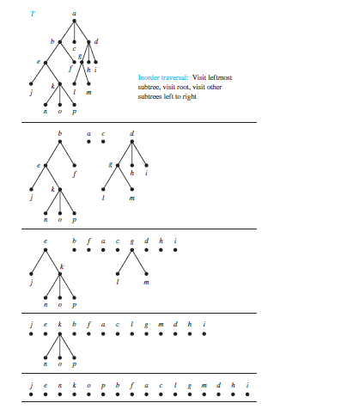


Slide 45
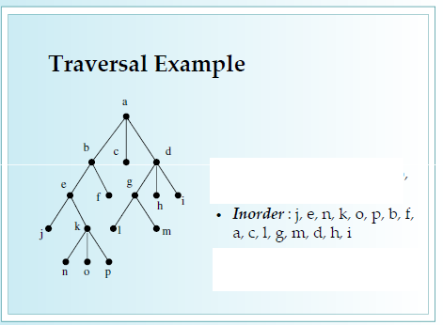

Slide 46
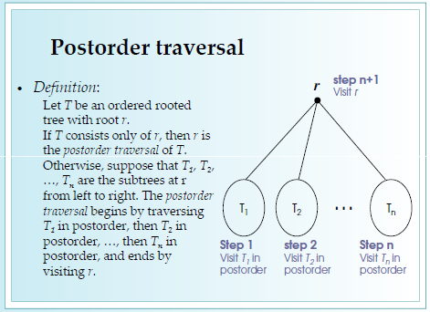

Slide 47
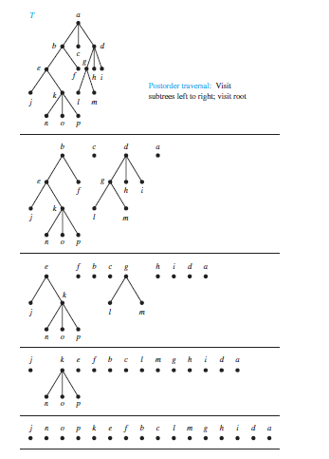


Slide 48
